Slide 1


Debo Prosad Dutta
01.05.2022

Slide 2

Outline
Executive Summary
Introduction
Methodology
Results
Conclusion
Appendix

Slide 3
Executive Summary
Summary of project –
Now a days we are in commercial space age era. In the market so many companies are there who are trying to make space object
affordable. SpaceX is the most successful among them. In this project we are going to find out success factor of launch of space object in
the cheapest affordable price.
Summary of methodologies –
To get the insights we have used SpaceX API and Web Scrapping Technique for Data Collection. We have used Data Wrangling
methodology to prepare data for analysis. We have done exploratory data analysis using SQL and matplotlib. After that we have used
folium methodology and dash to create interactive Dashboard. We have used Logistics Regression, SVC, Decision Tree Classifier, KNN for
machine learning prediction.
Summary of all results –
From the analysis we have found that affordable launching of space object of SpaceX is mainly dependent on few parameters. Those are
launching site location, payload and booster version category.

Slide 4
Introduction
Project background and context –
World is in commercial space age. Now every private company wants to make
launching affordable to remain competitive in the space business. SpaceX has the
lead in the business. SpaceX is able to make launching cost cheapest. In this
project we are going to analyze factors responsible for SpaceX successful launch.
Problems you want to find answers –
Here we are going analyze how the launch of space object could be successful
based on some factors within minimal cost.

Slide 5

Section 1

Slide 6
Methodology
Executive Summary
Data collection methodology:
We have used SpaceX API and Web Scrapping to collect Data.
Perform data wrangling
In the collected data there are several there are several different cases where the booster did not land successfully. Here we will convert failed landing with 0 and successful landing in 1.
Perform exploratory data analysis (EDA) using visualization and SQL
Perform interactive visual analytics using Folium and Plotly Dash
Perform predictive analysis using classification models
We will perform EDA , determine Training Labels, create column for class, standardize data, split data into training and test data. After that we will apply SVM, KNN, Classification trees, Logistic Regression and will find which method is best.

Slide 7
Data Collection
We have collected data using SpacX API and web scrapping described below by flowchart.
Start Data Collection
Data Collection by SpaceX API
Data Collection by Web Scrapping
Fail
Data Collection Status
Data Collection Status
Fail
Successful
Data Collection completed
Successful

Slide 8
Data Collection – SpaceX API
Start Data Collection using SpaceX API
Required function will be created for specific parameters
Storing of SpaceX API json response
Fail
Successful
Convert json response into Data frame
Import required Libraries
Process Status
Successful
Fail
Call function using Data frame as an argument
Process Status
Analyse Data Frame and store additional required data in corresponding empty list
Successful
Process Status
Fail
Process Status
Successful
Fail
Create dictionary using Data Frame and list
Process Status
Successful
Convert dictionary into new Data Frame
Process Status
Successful
Filter Data of new Data Frame for Booster Version Falcon 9
Data Frame is ready for use
Fail
Successful
Process Status
Fail
Process Status
Fail
Successful
Successful
Process Status
Calculate mean for PayloadMass using the .mean(). Then use the mean and the .replace()
function to replace np.nan values in the data with the mean you calculated.
Check for the number of column having Missing Values
Convert Data Frame into csv File
For more details of Data Collection using SpaceX API , GitHub details are given below.
GitHub Link - https://github.com/daboprasaddutta0/Applied-Data-Science-Capstone/blob/master/Week%201/F_A_Data_Collecting.ipynb

Slide 9
Data Collection – Web Scraping
Data Collection using Web Scrapping Technique
Install required python packages (Ex:beautifulsoup4,requests)
Import required Libraries
Define functions to process table content
Perform an HTTP GET method to request the Falcon9 Launch HTML page, as an HTTP response and store it.
Create an empty dictionary with keys from the extracted column names
Process Status
Process Status
Fail
Successful
Extract all column names from the HTML table header
Fail
Successful
Successful
Fail
Process Status
Successful
Using parsing extract data from rows and store it into dictionary
Process Status
Create a BeautifulSoup object from the HTML response
Process Status
Successful
Fail
Fail
Fail
Convert dictionary into Data Frame
Process Status
Fail
Data Frame is ready for use.
Successful
Process Status
Convert Data Frame to csv file.
Successful
For more details of Data Collection using Web Scrapping Technique, GitHub details are given below.
GitHub Link - https://github.com/daboprasaddutta0/Applied-Data-Science-Capstone/blob/master/Week%201/F_A_Web_Scrapping.ipynb

Slide 10
Data Wrangling
In data wrangling part of the project , we will perform some Exploratory Data Analysis (EDA) to find some patterns in the data and determine what would be the label for training supervised models.
In the data set, there are several different cases where the booster did not land successfully. Sometimes a landing was attempted but failed due to an accident; for example, True Ocean means the mission outcome was successfully landed to a specific region of the ocean while False Ocean means the mission outcome was unsuccessfully landed to a specific region of the ocean. True RTLS means the mission outcome was successfully landed to a ground pad False RTLS means the mission outcome was unsuccessfully landed to a ground pad. True ASDS means the mission outcome was successfully landed on a drone ship False ASDS means the mission outcome was unsuccessfully landed on a drone ship.
In this lab we will mainly convert those outcomes into Training Labels with 1 means the booster successfully landed 0 means it was unsuccessful.
Start Data Wrangling
Import required Libraries
Fail
Load the previously created Datasets in Data Frame
Process Status
Successful
Identify and calculate the percentage of the missing values in each attribute
Fail
Process Status
Create a landing outcome label from Outcome column
Calculate the number and occurrence of each orbit
Calculate the number of launches on each site
Identify which columns are numerical and categorical
Successful
Fail
Successful
Check the Data Frame
Convert Data Frame into csv for future purpose
Process Status
New Data Frame is ready after Data Wrangling
For more details of Data Wrangling, GitHub details are given below.
GitHub Link - https://github.com/daboprasaddutta0/Applied-Data-Science-Capstone/blob/master/Week%201/F_A_Data_Wrangling.ipynb

Slide 11
EDA with Data Visualization
• The FlightNumber vs. PayloadMass and scatterplot overlay the outcome of the launch. It seems the more massive the payload, the less likely the first stage will return. We found that different launch sites have different success rates. CCAFS LC-40, has a success rate of 60 %, while KSC LC-39A and VAFB SLC 4E has a success rate of 77%.
• The FlightNumber vs. LaunchSite scatterplot. It seems the launch sites which have higher success rate have higher number of flight number.
• The PayloadMass vs. LaunchSite scatterplot. The VAFB-SLC launchsite there are no rockets launched for heavypayload mass(greater than 10000).
• Bar Chart to Visualize the relationship between success rate of each orbit type. ES-L1, GEO, HEO, SSO orbits have highest success rate among other orbits.
• The FlightNumber vs. Orbit type scatterplot. In the LEO orbit the Success appears related to the number of flights; on the other hand, there seems to be no relationship between flight number when in GTO orbit.
• The PayloadMass vs. Orbit type scatterplot. With heavy payloads the successful landing or positive landing rate are more for Polar,LEO and ISS. However for GTO we cannot distinguish this well as both positive landing rate and negative landing(unsuccessful mission) are both there here.
• Visualization of the launch success yearly trend. The success rate since 2013 kept increasing till 2020.
For more details of EDA with Data Visualization, GitHub details are given below.
GitHub Link - https://github.com/daboprasaddutta0/Applied-Data-Science-Capstone/blob/master/Week%202/F_A_Exploratory_Data_Analysis_Pandas_Matplotlib.ipynb

Slide 12
EDA with SQL
SELECT DISTINCT LAUNCH_SITE FROM SPACEXTBL. (Display the names of the unique launch sites in the space mission).
SELECT * FROM SPACEXTBL WHERE LAUNCH_SITE LIKE 'CCA%' LIMIT 5. (Display 5 records where launch sites begin with the string 'CCA’).
SELECT SUM(PAYLOAD_MASS__KG_) FROM SPACEXTBL WHERE CUSTOMER = 'NASA (CRS)’. (Display the total payload mass carried by boosters launched by NASA (CRS)).
SELECT AVG(PAYLOAD_MASS__KG_) FROM SPACEXTBL WHERE BOOSTER_VERSION = 'F9 v1.1’. (Display average payload mass carried by booster version F9 v1.1)
SELECT MIN(DATE) FROM SPACEXTBL WHERE LANDING__OUTCOME ='Success (ground pad)’. (List the date when the first successful landing outcome in ground pad was achieved.)
SELECT BOOSTER_VERSION FROM SPACEXTBL WHERE PAYLOAD_MASS__KG_ > 4000 AND PAYLOAD_MASS__KG_<6000 AND LANDING__OUTCOME = 'Success (drone ship)’. (List the names of the boosters which have success in drone ship and have payload mass greater than 4000 but less than 6000)
SELECT COUNT(*) AS "TOTAL NUMBER OF SUCCESSFUL AND FAILURE" FROM SPACEXTBL. (List the total number of successful and failure mission outcomes)
SELECT DISTINCT BOOSTER_VERSION FROM SPACEXTBL WHERE PAYLOAD_MASS__KG_ = (SELECT MAX(PAYLOAD_MASS__KG_) FROM SPACEXTBL). (List the names of the booster_versions which have carried the maximum payload mass. Use a subquery)
SELECT BOOSTER_VERSION, LAUNCH_SITE FROM SPACEXTBL WHERE DATE LIKE '2015%' AND LANDING__OUTCOME = 'Failure (drone ship)’. (List the names of the booster_versions which have carried the maximum payload mass. Use a subquery)
SELECT BOOSTER_VERSION, LAUNCH_SITE FROM SPACEXTBL WHERE DATE LIKE '2015%' AND LANDING__OUTCOME = 'Failure (drone ship)’. (List the failed landing_outcomes in drone ship, their booster versions, and launch site names for in year 2015)
SELECT LANDING__OUTCOME, COUNT(*) FROM SPACEXTBL WHERE DATE BETWEEN '2010-06-04' AND '2017-03-20' GROUP BY LANDING__OUTCOME ORDER BY COUNT(*) DESC . (Rank the count of landing outcomes (such as Failure (drone ship) or Success (ground pad)) between the date 2010-06-04 and 2017-03-20, in descending order)
For more details of EDA with SQL, GitHub details are given below.
GitHub Link - https://github.com/daboprasaddutta0/Applied-Data-Science-Capstone/blob/master/Week%202/F_A_Exploratory_Data_Analysis_SQL.ipynb

Slide 13
Build an Interactive Map with Folium
Here some map objects such as map, circles, markers, PolyLines, MarkerCluster, MousePosition, Popup are added to a folium map
Map objects are created to pinning launch sites on the map.
Circle objects are created to add a highlighted circle area with a text label on a specific coordinate.
Marker objects are created to mark location on map.
PolyLines objects created to draw line between two co-ordinates.
MarkerCluster objects are created because it can be a good way to simplify a map containing many markers having the same coordinate.
MousePosition objects are created to get coordinate for a mouse over a point on the map. As such, while you are exploring the map, you can easily find the coordinates of any points of interests (such as railway).
Popup objects are created to show the name on the map.
For more details of Map with Folium, GitHub details are given below.
GitHub Link - https://github.com/daboprasaddutta0/Applied-Data-Science-Capstone/blob/master/Week%203/F_A_Data_Visualization_Folium.ipynb

Slide 14
Build a Dashboard with Plotly Dash
Here we have used dropdown, pie chart, range-slider, scatter chart, two call back function for our interactive dashboard.
In the dropdown we can select all launch sites or a specific launch sites. If we select all launch site or specific launch site then for that we can observe success rate of all launch sites in pie chart and scatter chart for Payload Mass(Kg) vs class.
Pie chart is created for check success rate for all launch sites and success and failed rate of selected launching sites.
Scatter chart is created to observe Payload Mass(Kg) vs class relation for all launching sites or specific launching sites.
Range Slider is used to determine range of Payload Mass.
Inside call back function pie and scatter chart mechanism is defined.
For more details of Dashboard with Plotly Dash, GitHub details are given below.
GitHub Link - https://github.com/daboprasaddutta0/Applied-Data-Science-Capstone/blob/master/Week%203/F_A_Hands_On_Interactive_Dashboard_with_Plotly_Dash.txt

Slide 15
Predictive Analysis (Classification)
After importing required libraries and defining confusion matrix function data is loaded into Data Frame. NumPy array is created from the column Class in data, by applying the method to_numpy() then assign it to the variable Y. Standardize the data in X then reassign it to the variable X. Function train_test_split to split the data X and Y into training and test data. Classification (logistic regression, support vector machine, decision tree classifier, k nearest neighbors) object is created then GridSearchCV object with cv = 10 is created. Fit the object to find the best parameters from the dictionary. Calculate the accuracy of created different objects on the test data using the method score. At last the methods performs best are identified.
Fail
Fail
Start predictive analysis process
Import required libraries
Define the function for confusion matrix
Process
status
Load Data in Data Frames
Process
status
Successful
Successful
Use the function train_test_split to split the data X and Y into training and test data.
Successful
Fail
Create a NumPy array from the column Class in Data Frame data,
by applying the method to_numpy() then assign it to the variable Y
Process
status
Standardize the data in X then reassign it to the variable X using preprocessing and StandardScaler
Successful
Process
status
Process
status
Fail
Fail
Successful
Process
status
Successful
Calculate the accuracy of created different objects on the test data using the method score
Fail
Successful
Create different type of classification (logistic regression, support vector machine, decision tree classifier, k nearest neighbors) object then create a GridSearchCV object with cv = 10. Fit the object to find the best parameters from the dictionary.
Find the method performs best
Process
status
Fail
Process
status
Fail
Successful
Best accuracy is found for classification models
For more details of Predictive Analysis (Classification), GitHub details are given below.
GitHub Link - https://github.com/daboprasaddutta0/Applied-Data-Science-Capstone/blob/master/Week%204/F_A_Machine_Learning_Prediction.ipynb

Slide 16
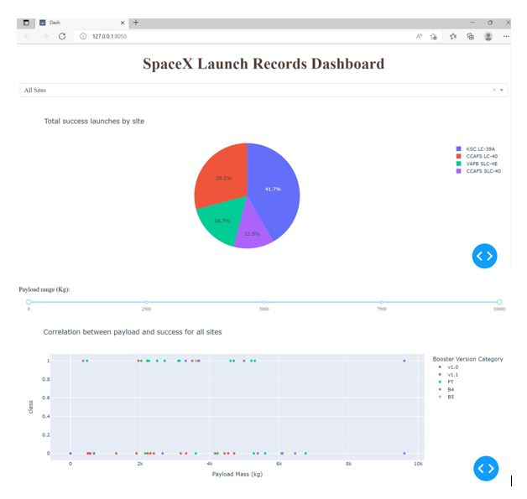
Results
Exploratory data analysis is done using SQL and Matplotlib. From FlightNumber vs. PayloadMass scatter plot we see that different launch sites have different success rates. CCAFS LC-40, has a success rate of 60 %, while KSC LC-39A and VAFB SLC 4E has a success rate of 77%. From FlightNumber vs LaunchSite scatter plot we found that highly successful launch sites have higher flight number. From Payload vs Launch Site scatter plot we observe Payload Vs. Launch Site scatter point chart you will find for the VAFB-SLC launch site there are no rockets launched for heavypayload mass(greater than 10000). From Orbit vs Success rate bar chart we can see that launching in orbit ES-L1, GEO, HEO, SSO have the highest rate of success. From FlightNumber vs Orbit scatter plot we see that in the LEO orbit the Success appears related to the number of flights; on the other hand, there seems to be no relationship between flight number when in GTO orbit. From Payload vs Orbit scatter plot we see that With heavy payloads the successful landing or positive landing rate are more for Polar,LEO and ISS. However for GTO we cannot distinguish this well as both positive landing rate and negative landing(unsuccessful mission) are both there here. From year vs success rate line chart we can observe that the sucess rate since 2013 kept increasing till 2020.
In Predictive analysis maximum accuracy is 83.3%

Slide 17

Section 2

Slide 18
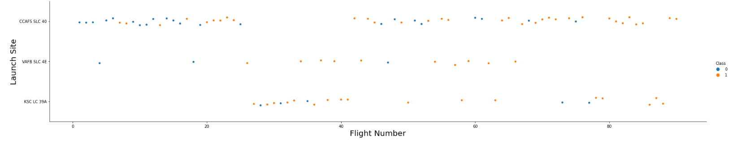
Flight Number vs. Launch Site
Scatter plot of Flight Number vs. Launch Site
We can see that launch site CCAFS SLC 40 has maximum flight number.

Slide 19
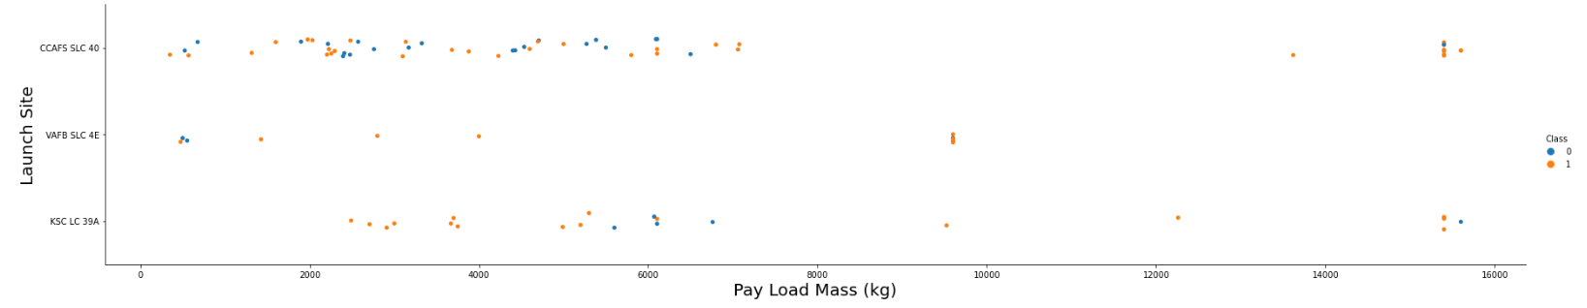
Payload vs. Launch Site
Scatter plot of Payload vs. Launch Site
We can observe Payload Vs. Launch Site scatter point chart you will find for the VAFB-SLC launchsite there are no rockets launched for heavy payload mass(greater than 10000).

Slide 20
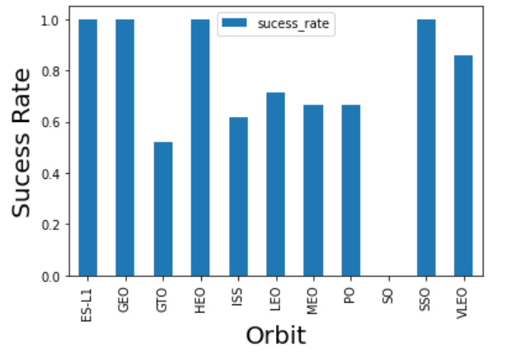
Success Rate vs. Orbit Type
Bar chart for the success rate of each orbit type
Show Analyze the plotted bar chart try to find which orbits have high success rate.

Slide 21
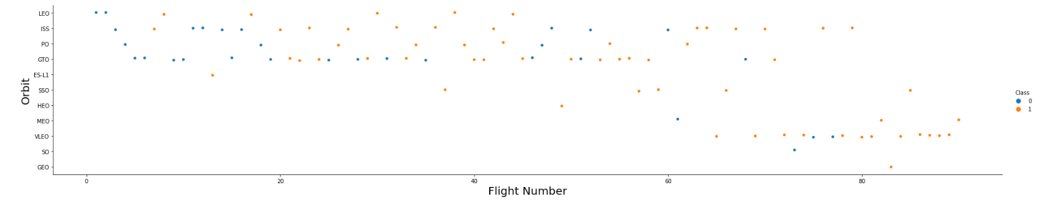
Flight Number vs. Orbit Type
Scater point of Flight number vs. Orbit type
We can see that in the LEO orbit the Success appears related to the number of flights; on the other hand, there seems to be no relationship between flight number when in GTO orbit.

Slide 22
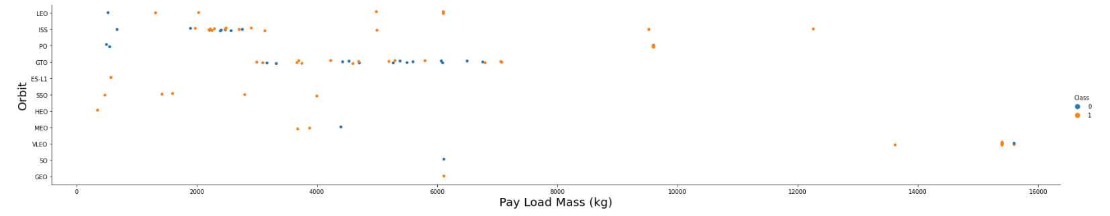
Payload vs. Orbit Type
Scater point of payload vs. orbit type
With heavy payloads the successful landing or positive landing rate are more for Polar, LEO and ISS. However for GTO we cannot distinguish this well as both positive landing rate and negative landing(unsuccessful mission) are both there here.

Slide 23
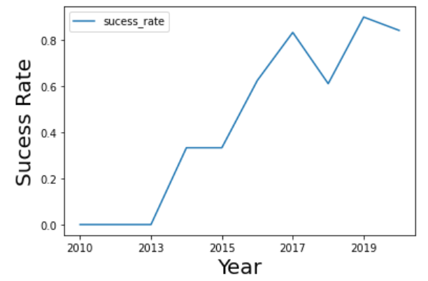
Launch Success Yearly Trend
Line chart of yearly average success rate
We can observe that the success rate since 2013 kept increasing till 2020.

Slide 24
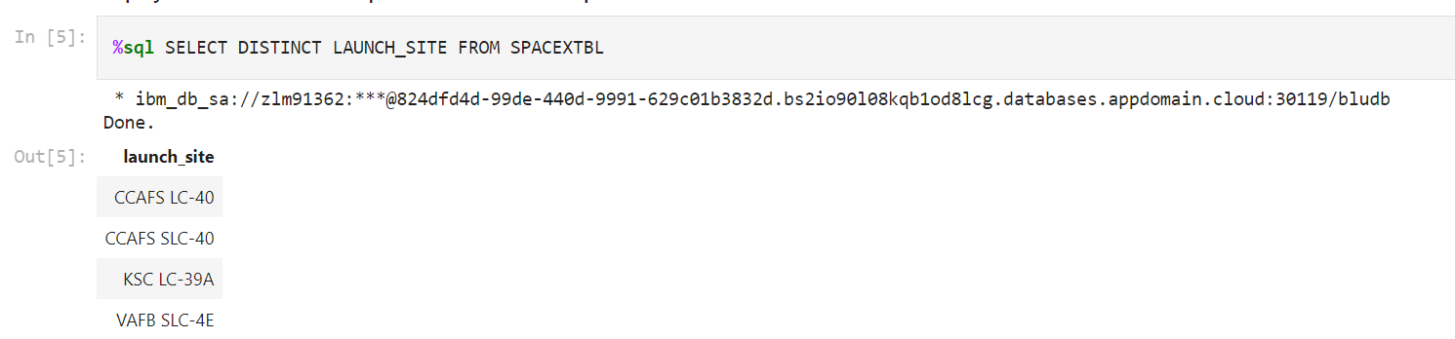
All Launch Site Names
Find the names of the unique launch sites
By this Select statement we are able to find unique launch site name from SPACEXTBL table.

Slide 25
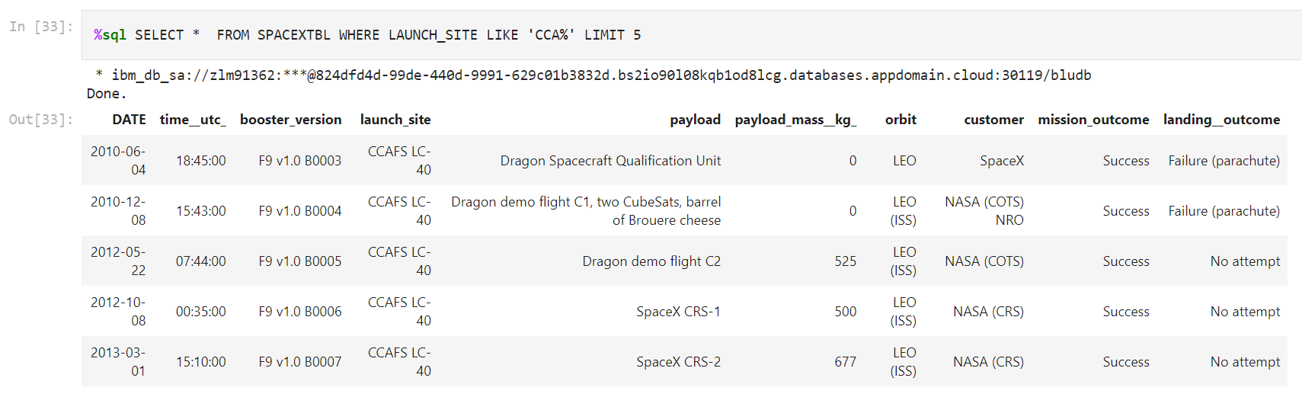
Launch Site Names Begin with 'CCA'
Find 5 records where launch sites begin with `CCA`.
In this select statement we use like operator to identifies records where launch site starts with ‘CCA’ in SPACEXTBL table.

Slide 26
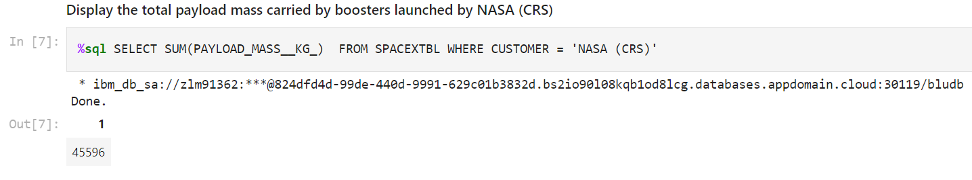
Total Payload Mass
Calculate the total payload carried by boosters from NASA
In this select statement we have used simple where clause and aggregate function SUM() to find relevant records from table SPACEXTBL table.

Slide 27
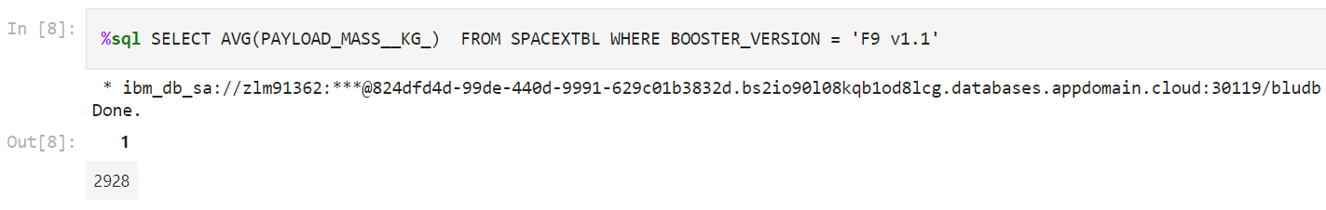
Average Payload Mass by F9 v1.1
Calculate the average payload mass carried by booster version F9 v1.1
In this select statement we have used simple where clause and aggregate function AVG() to find relevant records from table SPACEXTBL table.

Slide 28
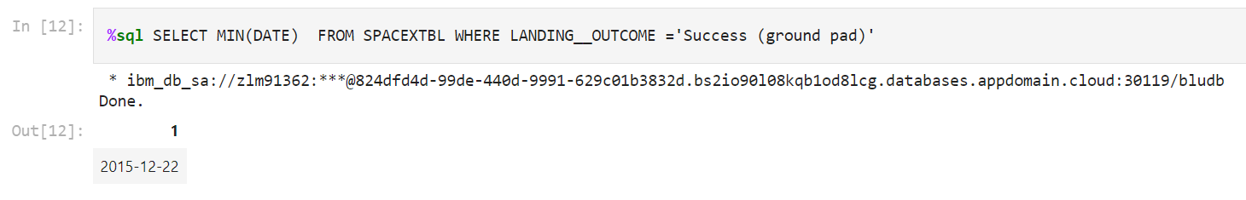
First Successful Ground Landing Date
Find the dates of the first successful landing outcome on ground pad
In this select statement we have used simple where clause and aggregate function AVG() to find relevant records from table SPACEXTBL table.

Slide 29
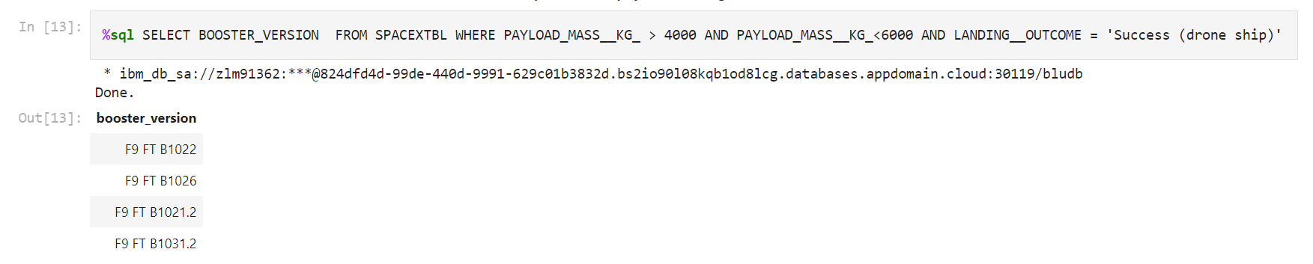
Successful Drone Ship Landing with Payload between 4000 and 6000
List the names of boosters which have successfully landed on drone ship and had payload mass greater than 4000 but less than 6000
In this select statement we have used simple where clause ; less than (<), greater than (>), and operator to find relevant records from table SPACEXTBL table.

Slide 30
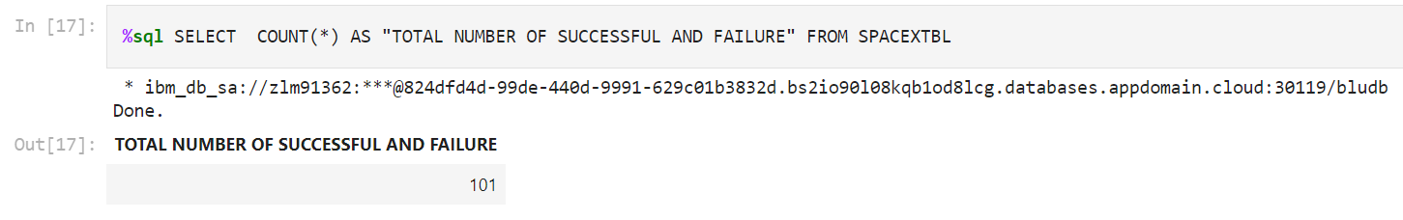
Total Number of Successful and Failure Mission Outcomes
Calculate the total number of successful and failure mission outcomes
In this select statement we have used count() and aliasing technique to find relevant records from table SPACEXTBL table.

Slide 31
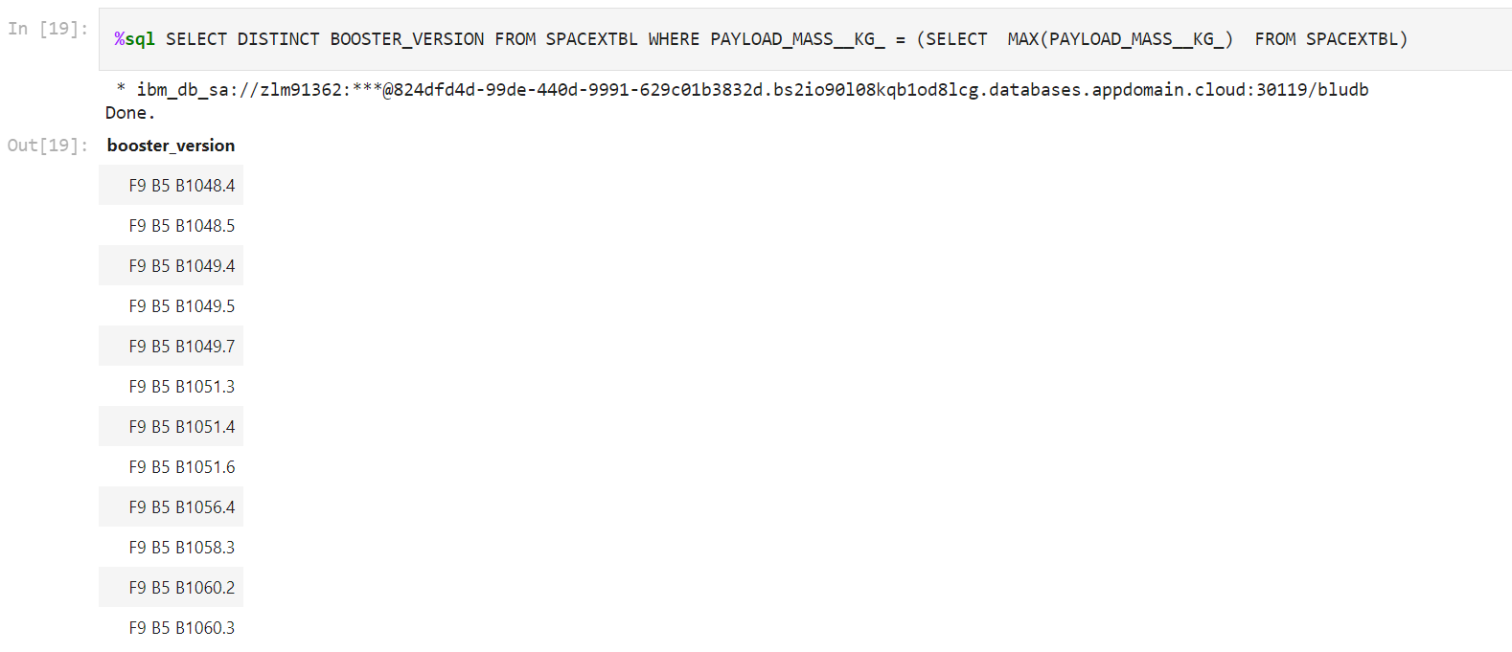
Boosters Carried Maximum Payload
List the names of the booster which have carried the maximum payload mass
Here we have used subquery and inside subquery aggregate function MAX() is used to find maximum payload which we have used in main query to find out the booster version carried out maximum payload from SPACEXTBL table.

Slide 32
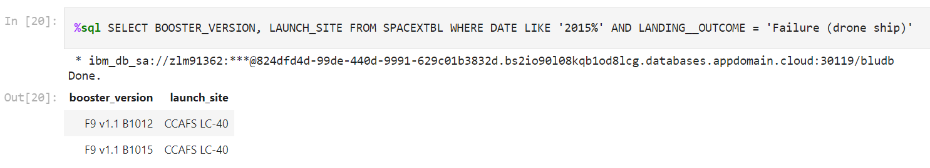
2015 Launch Records
List the failed landing_outcomes in drone ship, their booster versions, and launch site names for in year 2015
In this select statement we use like operator to identifies records where year is ‘2015’ and landing outcome is ‘Failure (drone ship)’ in SPACEXTBL table.

Slide 33
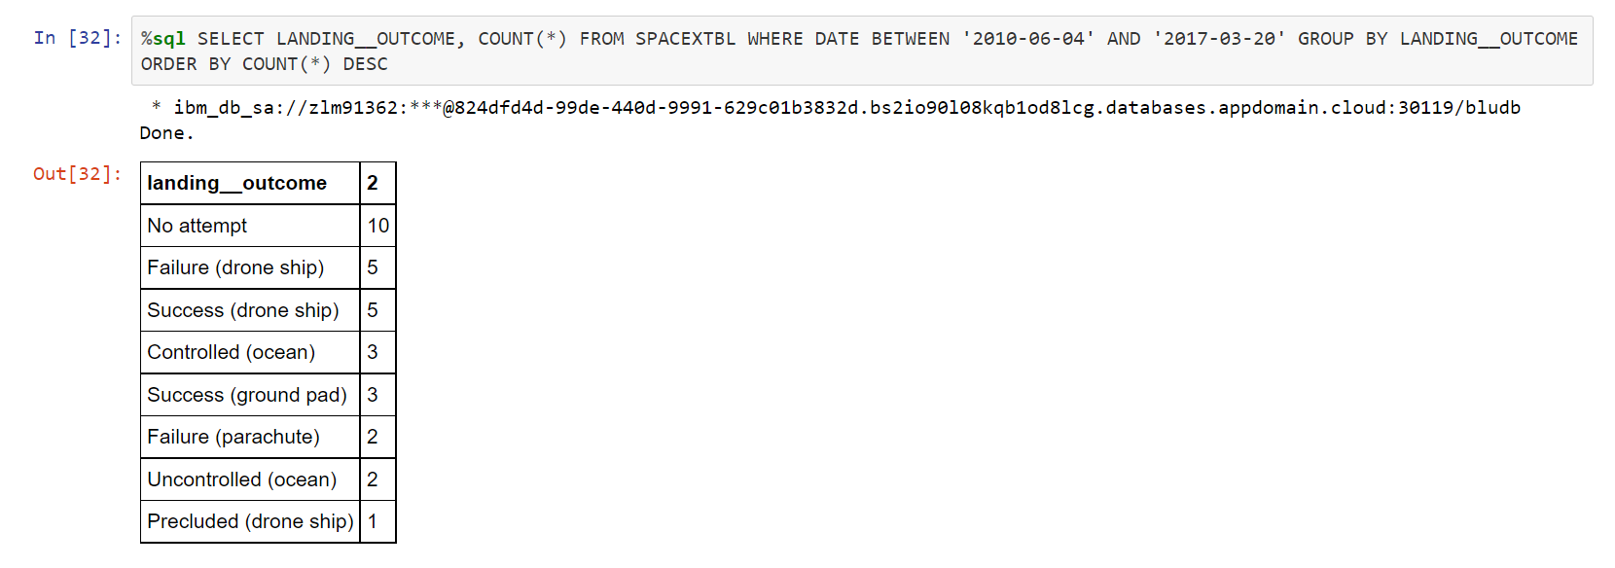
Rank Landing Outcomes Between 2010-06-04 and 2017-03-20
Rank the count of landing outcomes (such as Failure (drone ship) or Success (ground pad)) between the date 2010-06-04 and 2017-03-20, in descending order
In this select statement we have used count() function; between, and operator in where clause; group by and order by desc to identifies relevant records from SPACEXTBL table.

Slide 34

Section 3

Slide 35
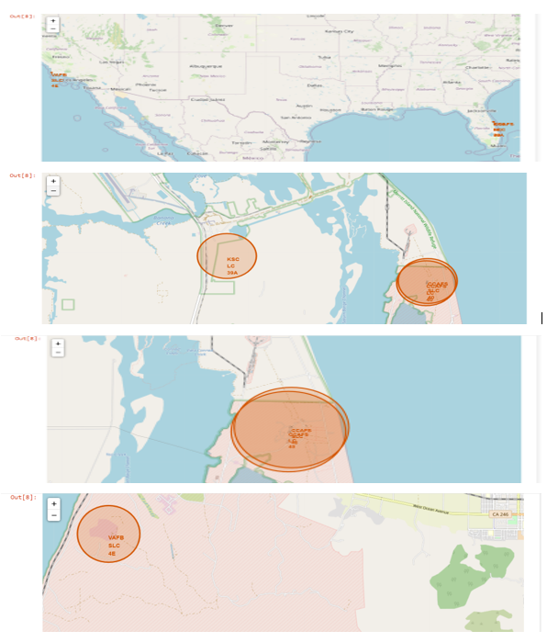
All Launch Sites in Folium Map
All successful launching sites are nearer to Ecuador.

Slide 36
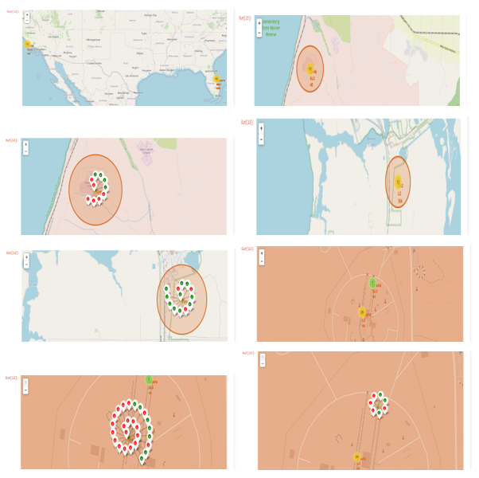
Folium Map With color-labeled launch outcomes on the map
We can observe that site KSC LC 39A have highest number of green markers.

Slide 37
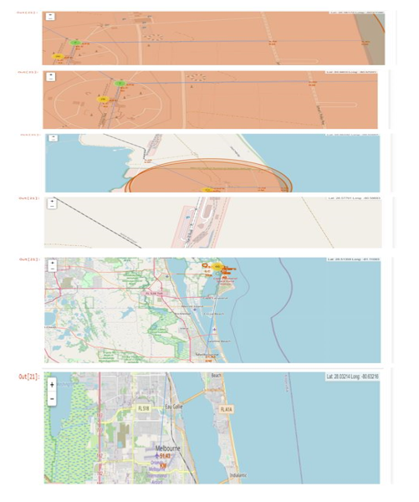
Folium Map for launch site ‘CCAFS SLC 40’ to its proximities such as railway, highway, coastline, with distance calculated and displayed
In the 1st figure nearest coastline distance from launch site CCAFS SLC 40 is 0.86 Km. In the 2nd figure nearest highway distance from launch site CCAFS SLC 40 is 0.58 Km. In the 3rd and 4th figure nearest railway distance from launch site CCAFS SLC 40 is 1.28 Km. In the 5th and 6th figure nearest city distance from launch site CCAFS SLC 40 is 51.43 Km

Slide 38

Section 4

Slide 39
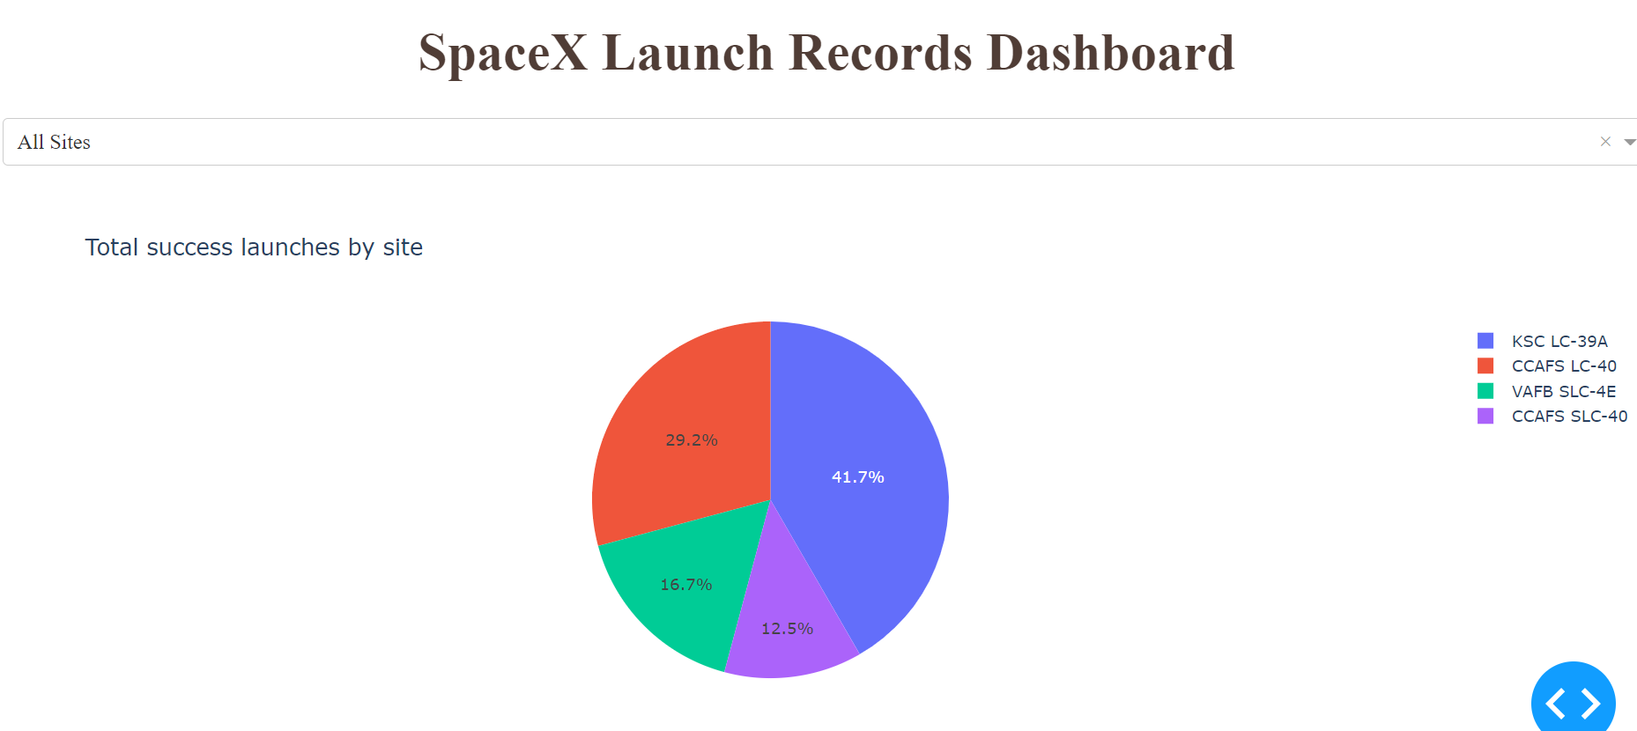
Launch success count for all sites, in a pie chart
In the above pie chart success rate for all sites is shown

Slide 40
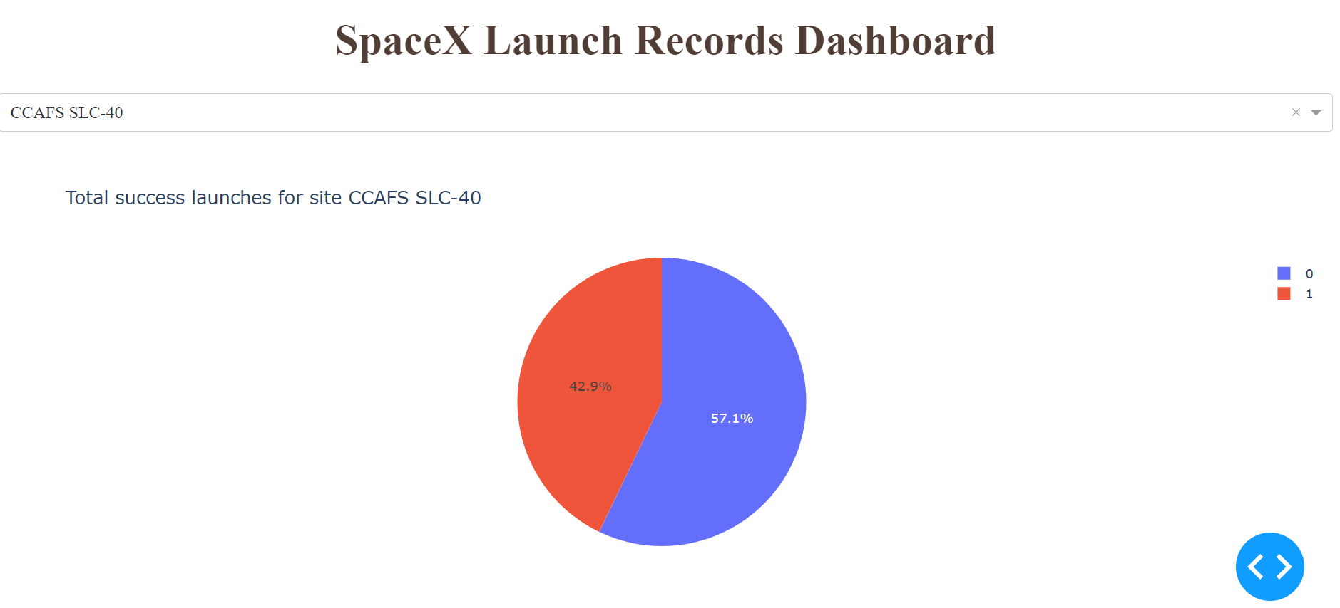
The pie chart for the launch site with highest launch success ratio
Launch site CCAFS SLC-40 has the highest launch success ratio.

Slide 41
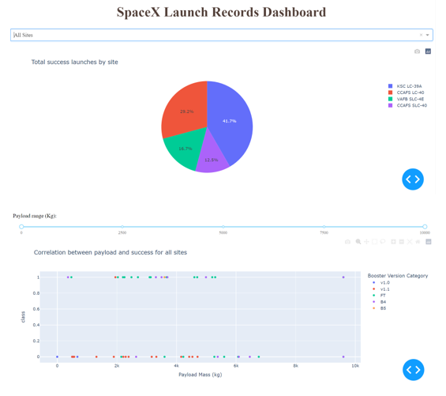
Payload vs. Launch Outcome scatter plot for all sites, with different payload selected in the range slider
In payload range 2k to 4k and booster version ‘FT’ have the largest success rate. e

Slide 42

Section 5

Slide 43
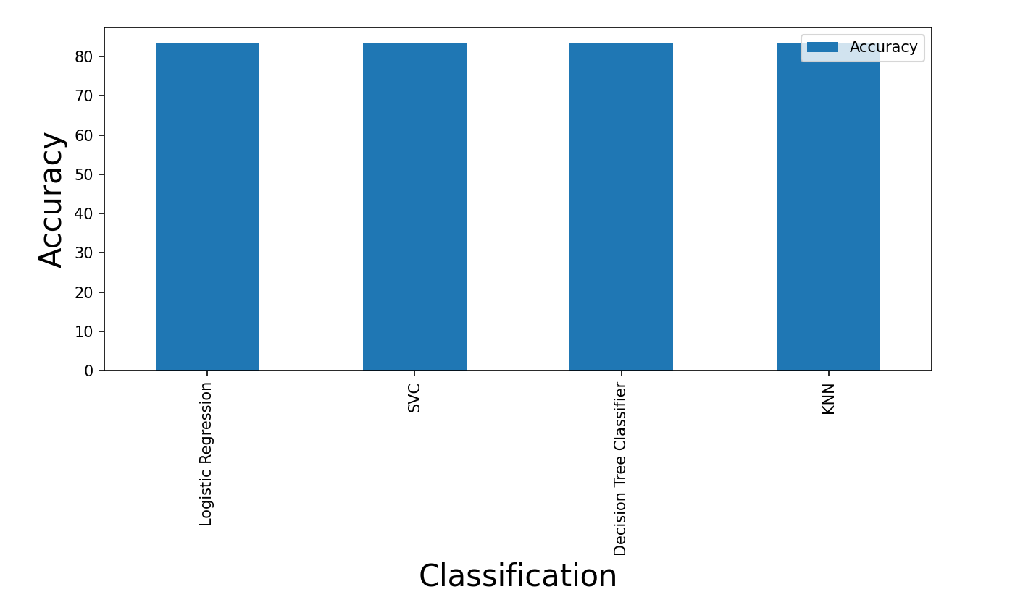
Classification Accuracy
All models have same accuracy for test data that is 83.3 %.

Slide 44
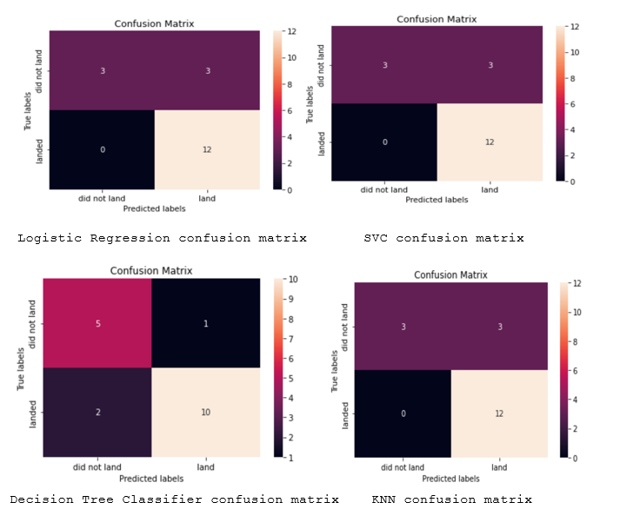
Confusion Matrix
Since accuracy of all model with test data are same hence we have shown confusion matrix for all.

Slide 45
Conclusions
Falcon 9 Falcon 9 rocket launches on its website with a cost of 62 million dollars; other providers cost upward of 165 million dollars each, much of the savings is because Space X can reuse the first stage.
Launch sites are in close proximity to Ecuador to minimize fuel consumption by using Earth's ~ 30km/sec eastward spin to help spaceships get into orbit.
Launch sites are in close proximity to coastline so they can fly over the ocean during launch, for at least two safety reasons - (1) crew has option to abort launch and attempt water landing, (2) minimize people and property at risk from falling debris.
Launch sites are in close proximity to highways, which allows for easily transport required people and property.
Launch sites are in close proximity to railways, which allows transport for heavy cargo. Launch sites are not in close proximity to cities, which minimizes danger to population dense areas.
Launch sites are not nearer to any city for example Melbourne city from launch site CCAFS SLC 40 is 51.43 Km away.

Slide 46
Appendix
SPACEXTBL table is created in IBM DB 2.
Links for created Data Sets.
Data Link1 - https://cf-courses-data.s3.us.cloud-object-storage.appdomain.cloud/IBM-DS0321EN-SkillsNetwork/datasets/dataset_part_1.csv
Data Link 2 - https://cf-courses-data.s3.us.cloud-object-storage.appdomain.cloud/IBM-DS0321EN-SkillsNetwork/datasets/dataset_part_2.csv
Data Link 3 - https://cf-courses-data.s3.us.cloud-object-storage.appdomain.cloud/IBM-DS0321EN-SkillsNetwork/datasets/dataset_part_3.csv
Link for SQL Query - https://github.com/daboprasaddutta0/Applied-Data-Science-Capstone/blob/master/Week%202/F_A_Exploratory_Data_Analysis_SQL.ipynb

Slide 47


